Slide 1
Protein k-mers for protein family assignment and downstream applications
Dr Yannis Nevers
ICube laboratory - CSTB team
Université de Strasbourg

Slide 2
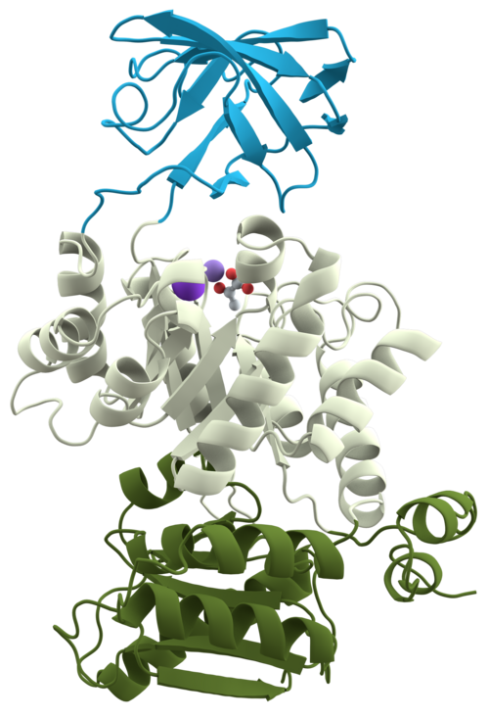
Protein sequences
Protein :
Macromolecule composed of a chain of amino-acid residues.
Its sequence is defined by the coding sequence (CDS) of a gene, encoded through the genetic code.
A protein sequence dictate its 3D structure and is often divided in domains

Slide 3
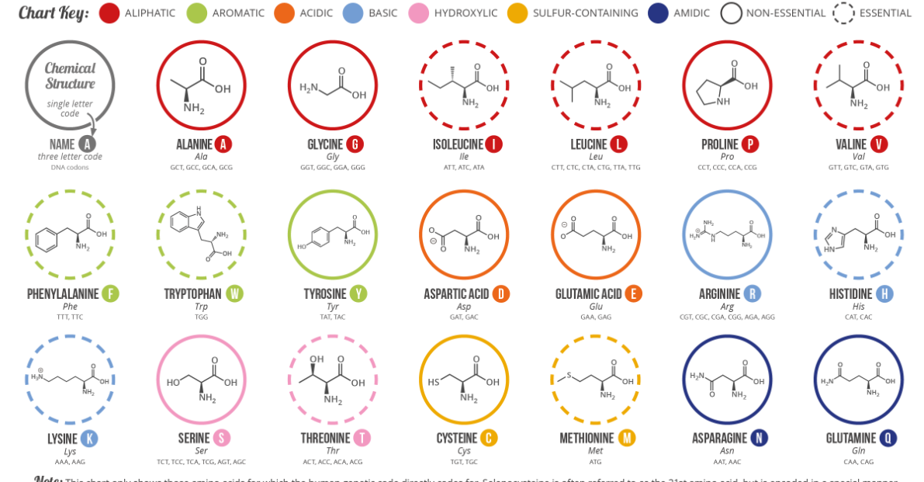
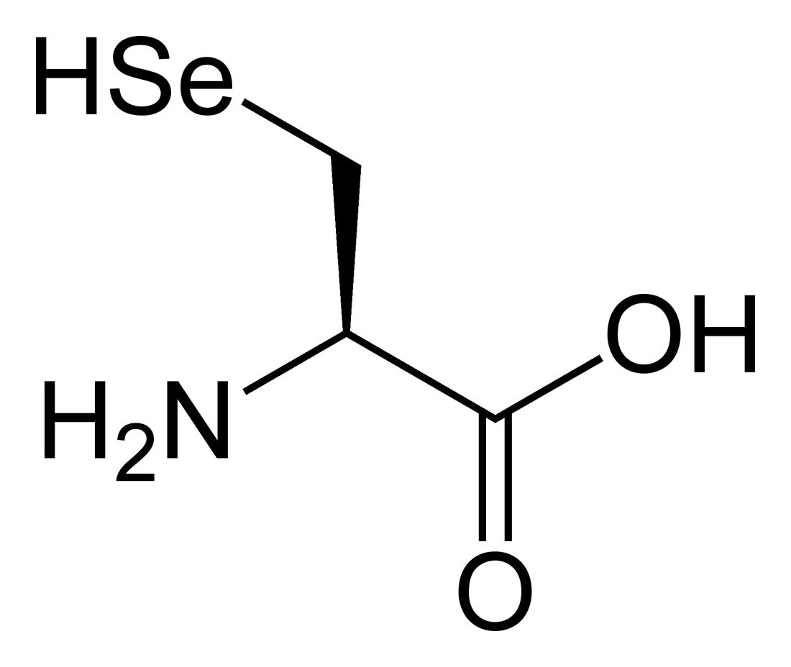
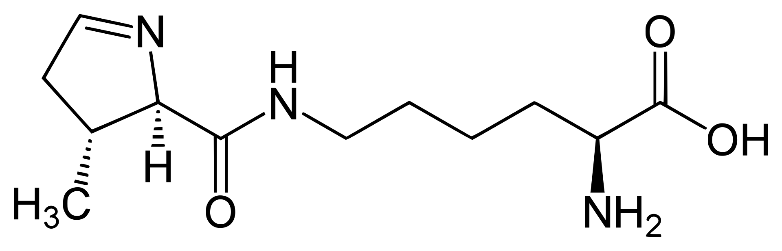
Amino-acid alphabet
20 canonical amino-acids
2 non-canonical ones
Selenocysteine U
Pyrrolysine O
Image from Compound Interests - https://www.compoundchem.com/2014/09/16/aminoacids/

Slide 4
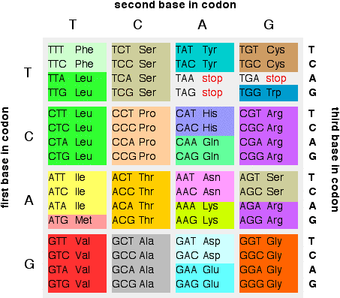
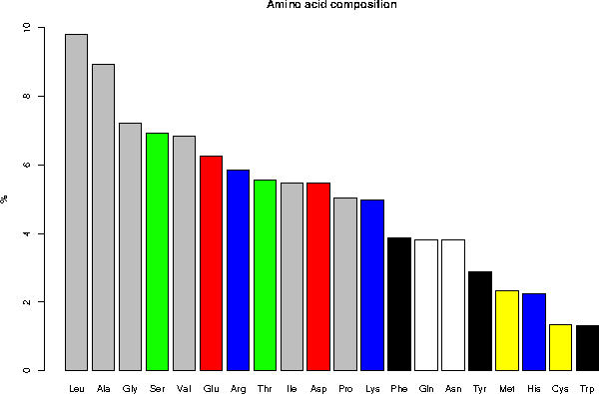
Amino acid alphabet
20 canonical amino-acids -> 20 lettere
Degenerate genetic code :
64 nucleotide triplets for 20 amino-acids
Amino-acids have heterogeneous frequency
Source: https://www.chemguide.co.uk

Slide 5
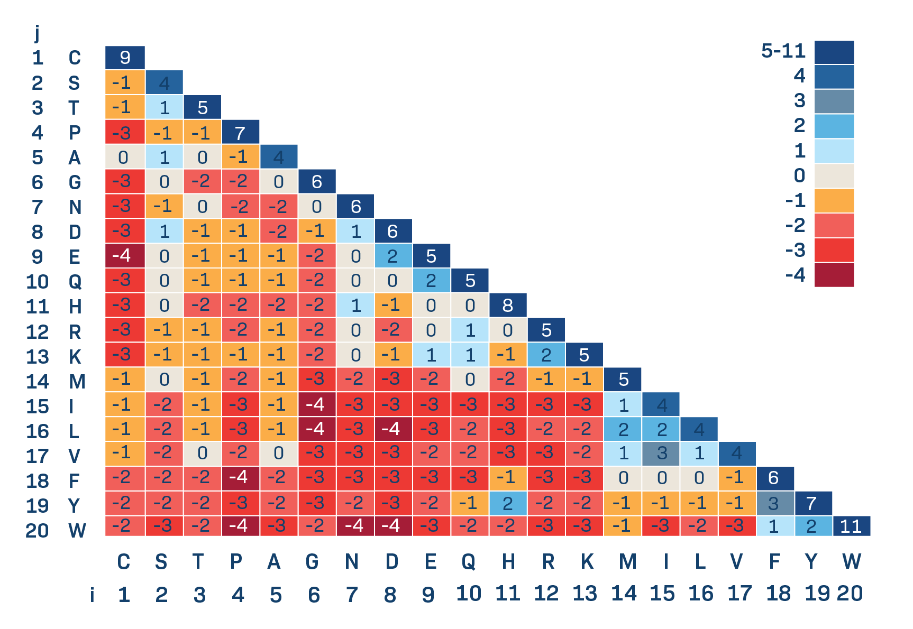
Amino acid alphabet
Amino-acids are not equally replaceable across evolution
BLOSUM62 substitution matrix
(Image from https://www.labxchange.org/library/items/lb:LabXchange:24d0ec21:lx_imag)

Slide 6
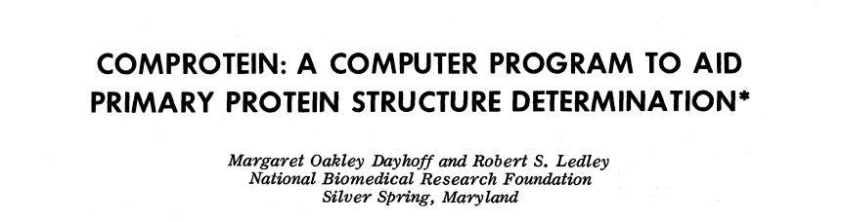
Usage of protein k-mers
MVLSPADKTNVKAAWGKVGAHAGEYGAEALERMFLSFPTTKTYFPHFDLSHGSAQVKGHGKKVADALT
MVLSPAD
VLSPADK
LSPADKT
…
First used in “protein sequencing”

Slide 7
Usage of protein k-mers
MVLSPADKTNVKAAWGKVGAHAGEYGAEALERMFLSFPTTKTYFPHFDLSHGSAQVKGHGKKVADALT
MVLSPAD
VLSPADK
LSPADKT
…
Alignement-free
sequence comparisons
Metagenomic applications
Fast sequence similarity search
Protein clustering
Sequence similarity estimation
Species classification
Open Reading Frame identification (in reads)

Slide 8
k in protein k-mers
k (protein) | Number of mers | Eq in nucleotide k
2 | 4,00E+02 | 5
3 | 8,00E+03 | 7
4 | 1,60E+05 | 9
5 | 3,20E+06 | 11
6 | 6,40E+07 | 13
7 | 1,28E+09 | 16
8 | 2,56E+10 | 18
9 | 5,12E+11 | 20
10 | 1,02E+13 | 22
11 | 2,05E+14 | 24
12 | 4,10E+15 | 26
13 | 8,19E+16 | 29
14 | 1,64E+18 | 31
15 | 3,28E+19 | 33
Number of possible kmers
20^{k} ≃ 4 ^{2.16k 0}
≃ 4 ^{2.16k}
More efficient than using CDS kmers (4 ^{3k})
One can use reduced alphabets to reduce it more…!

Slide 9
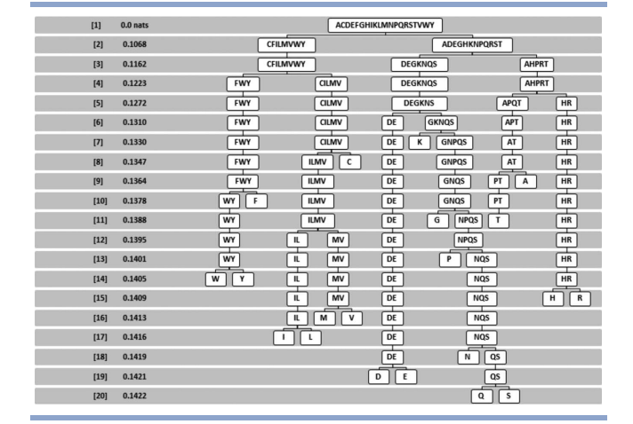
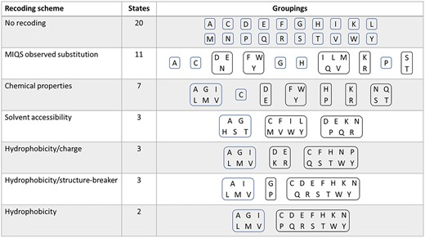
Reduced alphabet
Reducing the amino-acid
alphabet using physico-chemical properties
Many reduction methods exist leading to different alphabet size
Shown here: preserving long-range contact information in protein fold
Chang et al, 2023 Snekmer: protein sequence fingerprinting amino acid recoding
Solis, 2015. Amino acid alphabet reduction contact interactions in proteins

Slide 10
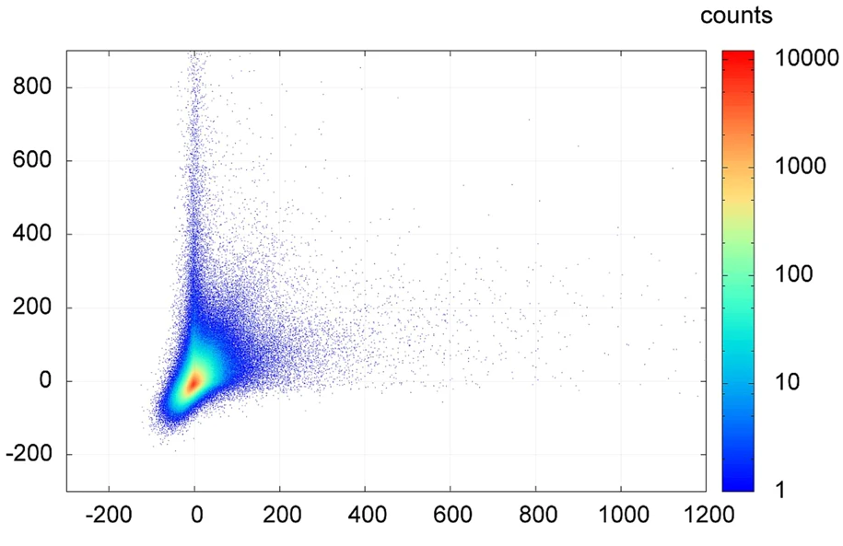
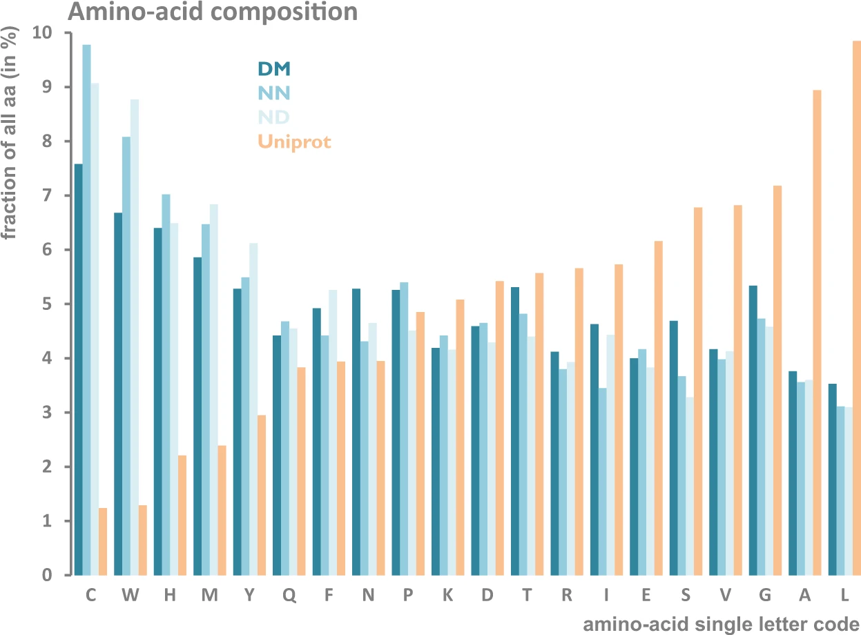
Protein k-mer frequencies
5-mer frequencies are not only dependant of amino-acid frequency
Related to protein domain organisation (Functional motifs)
Z-score in protein domains
Z-score outside of protein domains
From Global pentapeptide statistics are far away from expected distributions. Poznansky et al, 2018

Slide 11
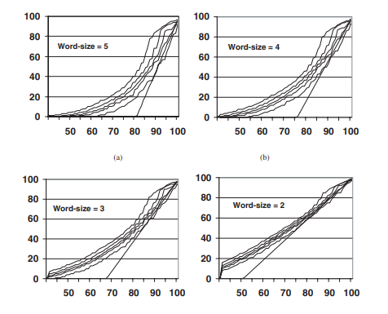
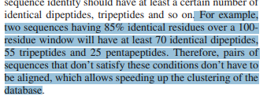
Protein clustering
Goal : reduce redundancy in protein databases (e.g cluster proteins with >90% identity )
k-mer identity
From Clustering homologous sequences large databases. Li et al, 2002
Strategy implemented in
CD-Hit (Fu et al, 2012)
UCLUST (Edgar,2010)
sequence identity
From Tolerating redundancy speeds up clustering of large databases. Li et al, 2002

Slide 12
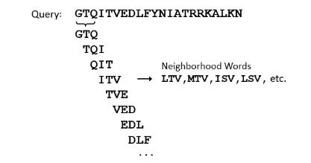
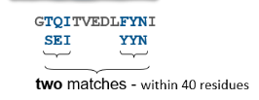
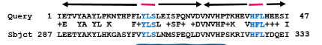
K-mers in sequence similarity search
Goal : identify homologs and measure sequence similarity (with or without alignment)
Example : BLASTP
Decomposition into words
Words finding
Match extension for alignment
Basic Local Alignment Search Tools, Altschul et al, 1990
Illustration from https://www.nlm.nih.gov/ncbi/workshops/2022-10_Basic-Web-BLAST/how-blast-works.html

Slide 13
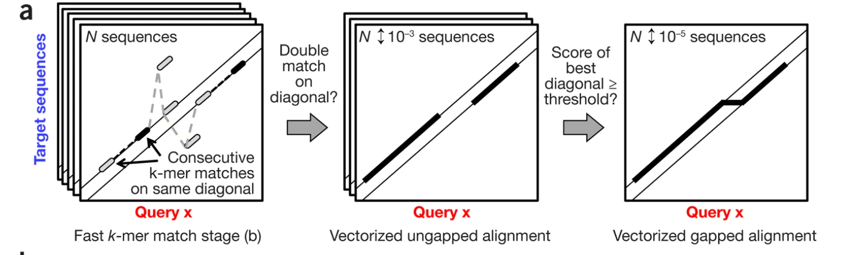
K-mers in sequence similarity search
Goal : identify homologs and measure similarity (with or without alignment)
MMSeqs 2
From MMseqs2 sensitive protein sequence searching massive data sets, Steinegger and Söding2017

Slide 14
Kmers in sequence similarity search
Tool | Type | Alignment | Default k | Reference
BLASTP | Similar words | Yes | 5 | (Altschul et al, 1990)
MMSeqs2 | Similar words | Yes | 7 | (Steinegger et al, 2017)
USEARCH | Exact match | Yes | 5 | (Edgar, 2010)
RAPSearch | Exact match - Reduced alphabet | Yes | 6 | (Zhao et al, 2012)
DIAMOND | Exact match - Reduced alphabet - Spaced words | Yes | 12 (15-24)* | (Buchfink et al, 2015)
Simrank | Exact match | No | 7 | (DeSantis et al, 2011)
kaamer | Exact match | No | 7 | (Deraspe et al, 2022)

Slide 15
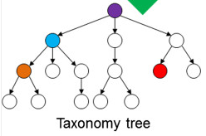
Protein k-mers in metagenomics
Species identification in reads
AGTCCCTAGAGATACACATTA
Translation into 6 frames
S P X R Y T L
Increase speed and reduce memory usage relative to nucleotide
Implemented in KRAKEN2X
(Wood et al, 2019)
V P R D T H
…
Reduced alphabet
N P X R Y T I
M P R D T H
…
Species identification
Adapted from Wood et Salzberg, 2014. Kraken.

Slide 16
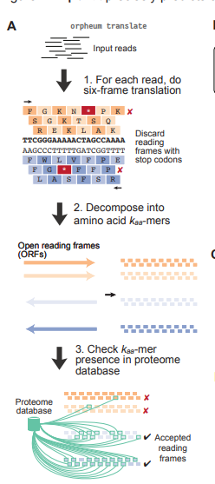
K-mers for protein sequence prediction
ORF Finding in RNA-seqs reads - Orpheum
Preprint : Single-cell transcriptomics for the 99.9% of species without reference genomes, Botvinnik et al, 2021

Slide 17
OMAmer
K-mer based fast protein placement into gene families

Slide 18
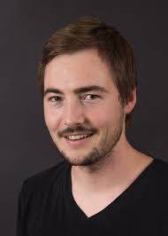







OMAmer
Globin
Task: placing proteins into gene families and subfamilies
Based only on k-mer content comparisons
Relies on an appropriate data structure : Hierarchical Orthologous Groups (HOGs)
Duplication
Victor
Rossier
zz
zz
Myoglobin
Hemoglobin

Slide 19
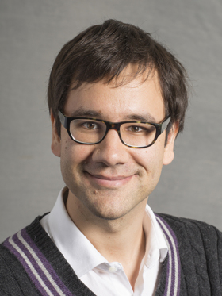

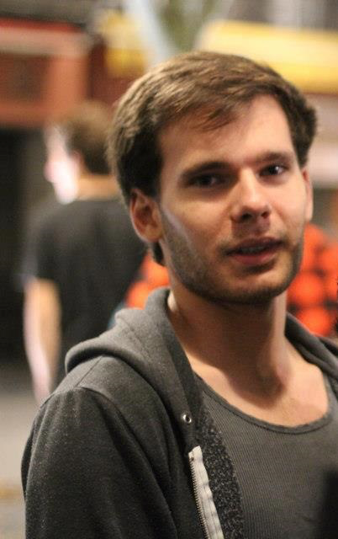


The OMA database
OMA : Orthology MAtrix
Sequence-similarity based orthology inference algorithm
Precomputed orthology relationship
Christophe
Dessimoz
Adrian
Altenhoff
Clément
Train
Natasha
Glover
Inputs :
Protein sequences as FASTA file
https://omabrowser.org/oma/home/
<
all vs. all
comparison
Identify closest pairs
GETHOGs
algorithm
Sequences of shared
ancestry
Orthologous pairs
(graph)
Hierarchical
Orthologous
Groups (HOGs)
Dessimoz et al., Nucl Acids Res 2006
Altenhoff et al, Nucl Acids Res 2011
Altenhoff et al. NAR 2024

Slide 20
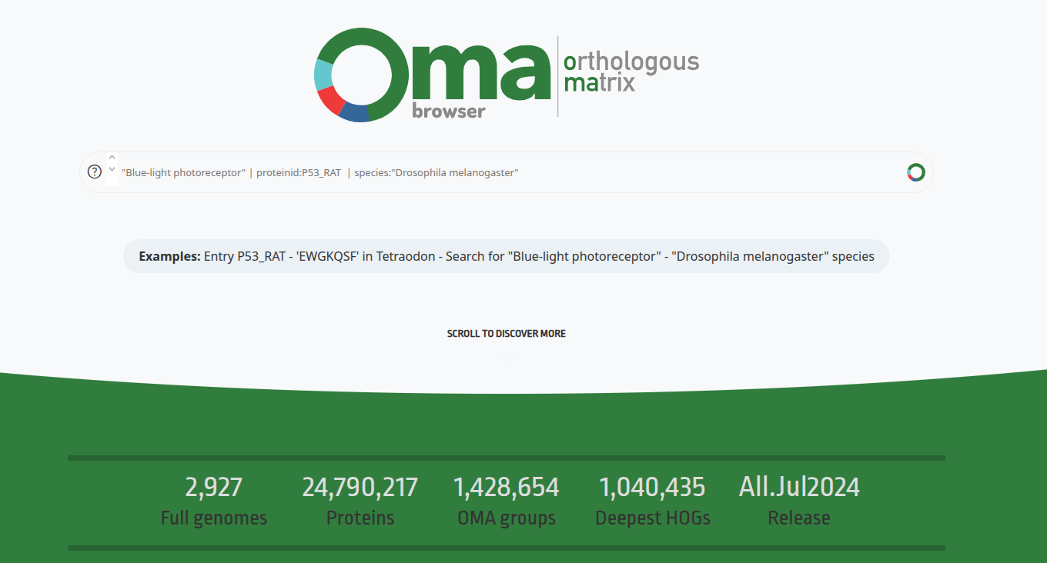
The OMA database
https://omabrowser.org

Slide 21
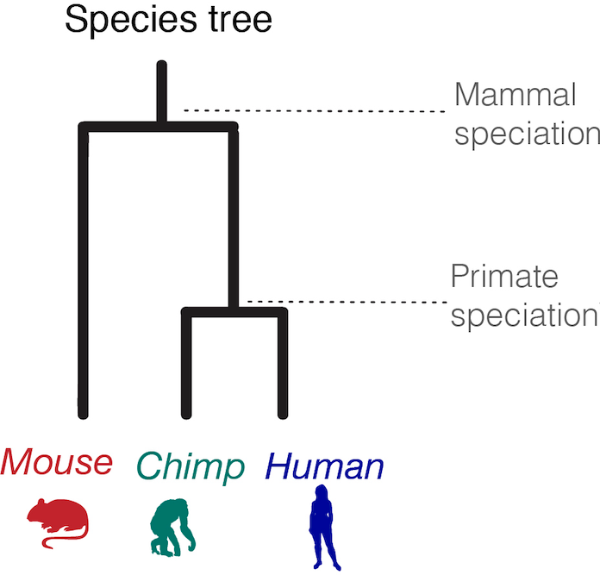
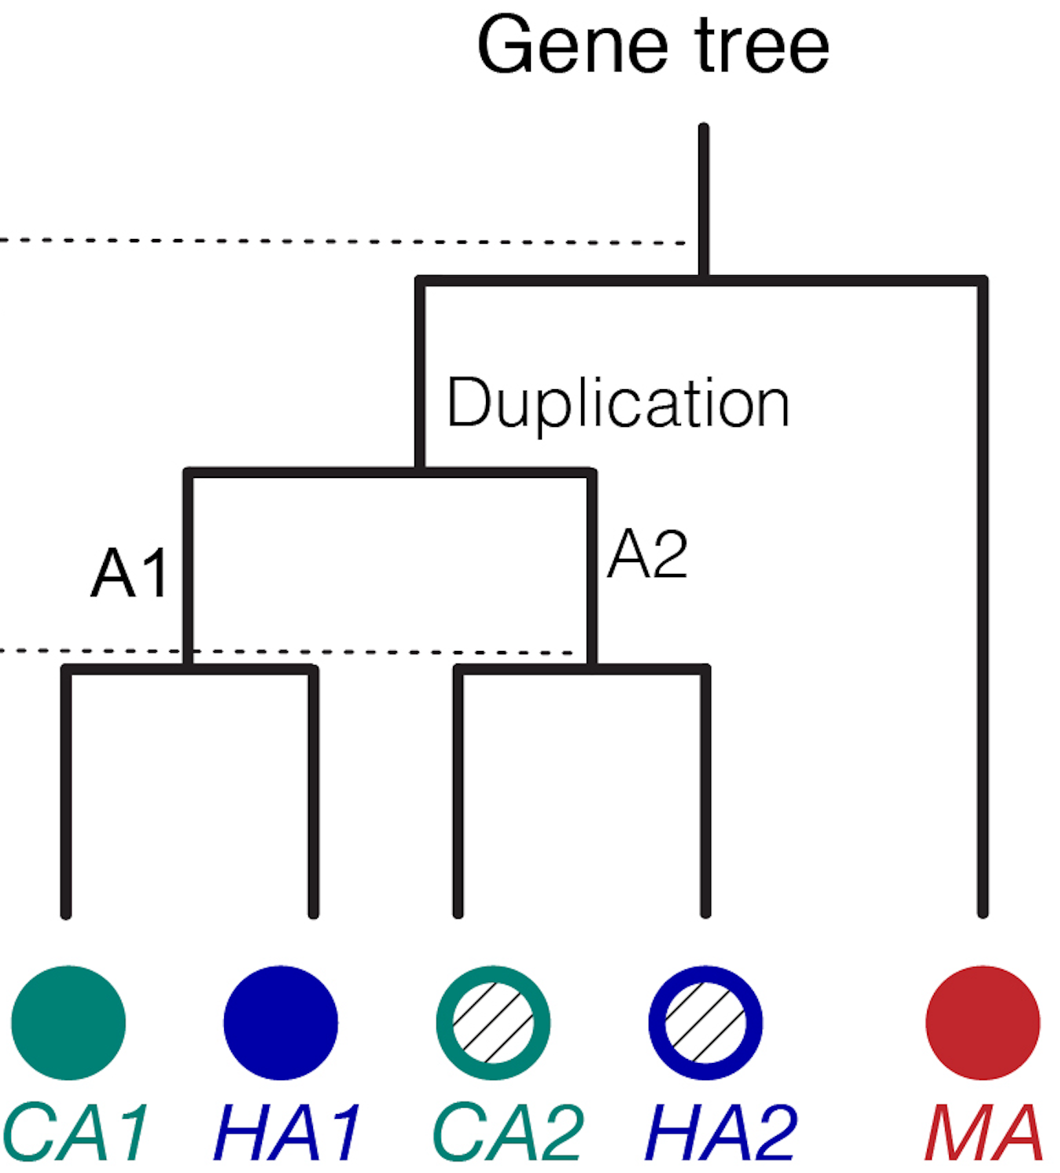
Hierarchical Orthologous Group
Genes descended from a common ancestral gene at a specific taxonomic level

Slide 22
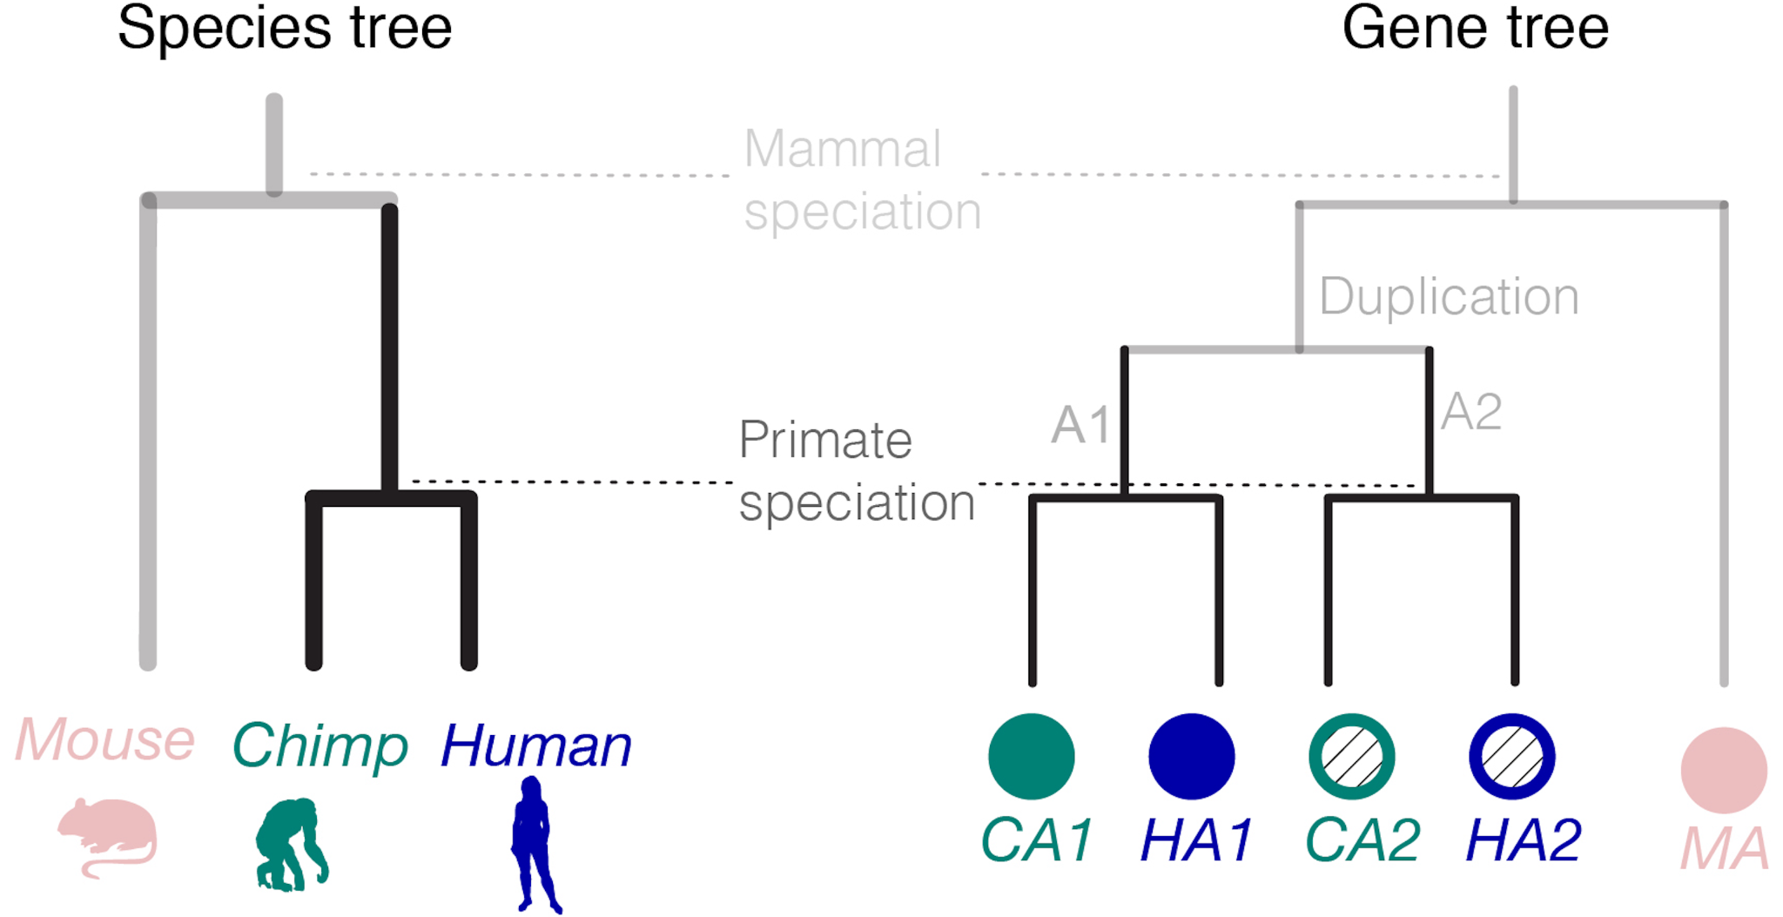
Hierarchical Orthologous Group
Genes descended from a common ancestral gene at a specific taxonomic level

Slide 23
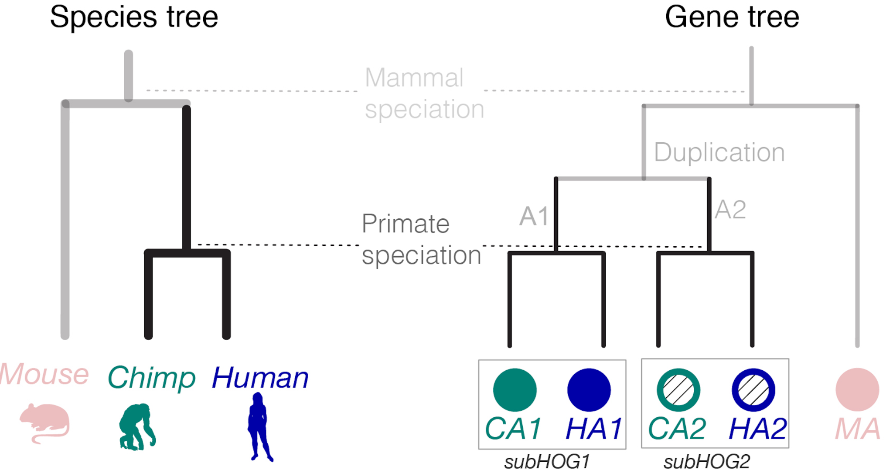
Hierarchical Orthologous Group
Genes descended from a common ancestral gene at a specific taxonomic level

Slide 24
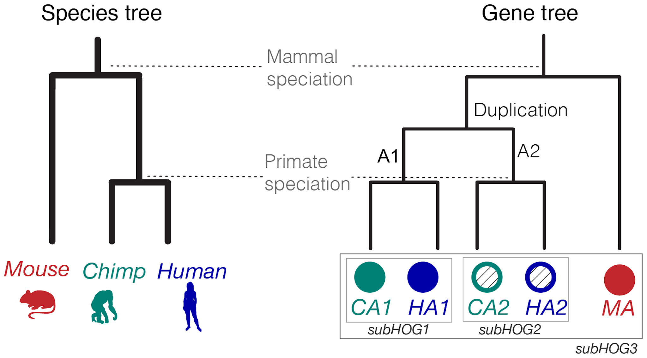
Hierarchical Orthologous Group
Hierarchical Orthologous Group
Genes descended from a common ancestral gene at a specific taxonomic level

Slide 25
The OMA database
https://omabrowser.org

Slide 26
Family placement vs closest sequence
Globin
Gene families reduce the number of comparisons
N⋅M is much lower than N²
M grows slowly with new genomes
The closest sequence does not always yield the correct subfamily !
N = query seq. nr.
M = HOG. nr.
Duplication
zz
zz
Myoglobin
Hemoglobin

Slide 27
HOGs and subHOGs k-mers
Query sequence
HOG
MHPYST
MHPYSTQMFS LQITVMEDSQ SDMSIELPLS
HPYSTQ
MHPYST
PYSTQM
HPYSTQ
PYSTQM
…
…
…
MSIELP
YSTQMD
YSTQMF
SIELPL
IELPLS
MHPYSTNCPD…
MHPYSTQMDF…
MHPYSTQMFS…

Slide 28
Process of HOG attribution
Find gene families (HOGs) sharing kmers with query
Filter by a “p-value” threshold α
Order by excess shared kmers over the expected (normcount)
Keep the best n results
Place into subfamilies of the selected HOGs - higher subfamily normcount
Return the placement

Slide 29
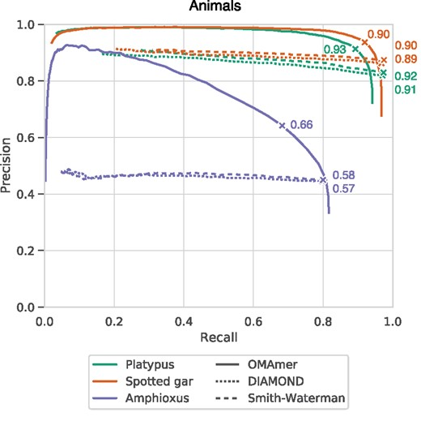
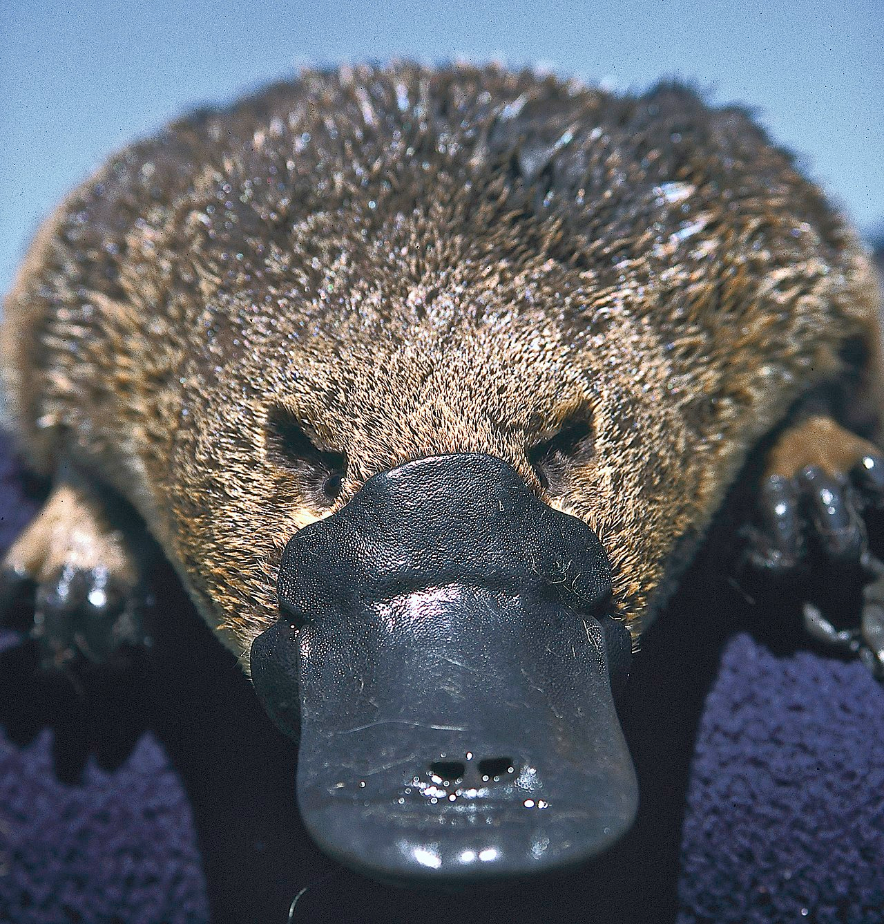
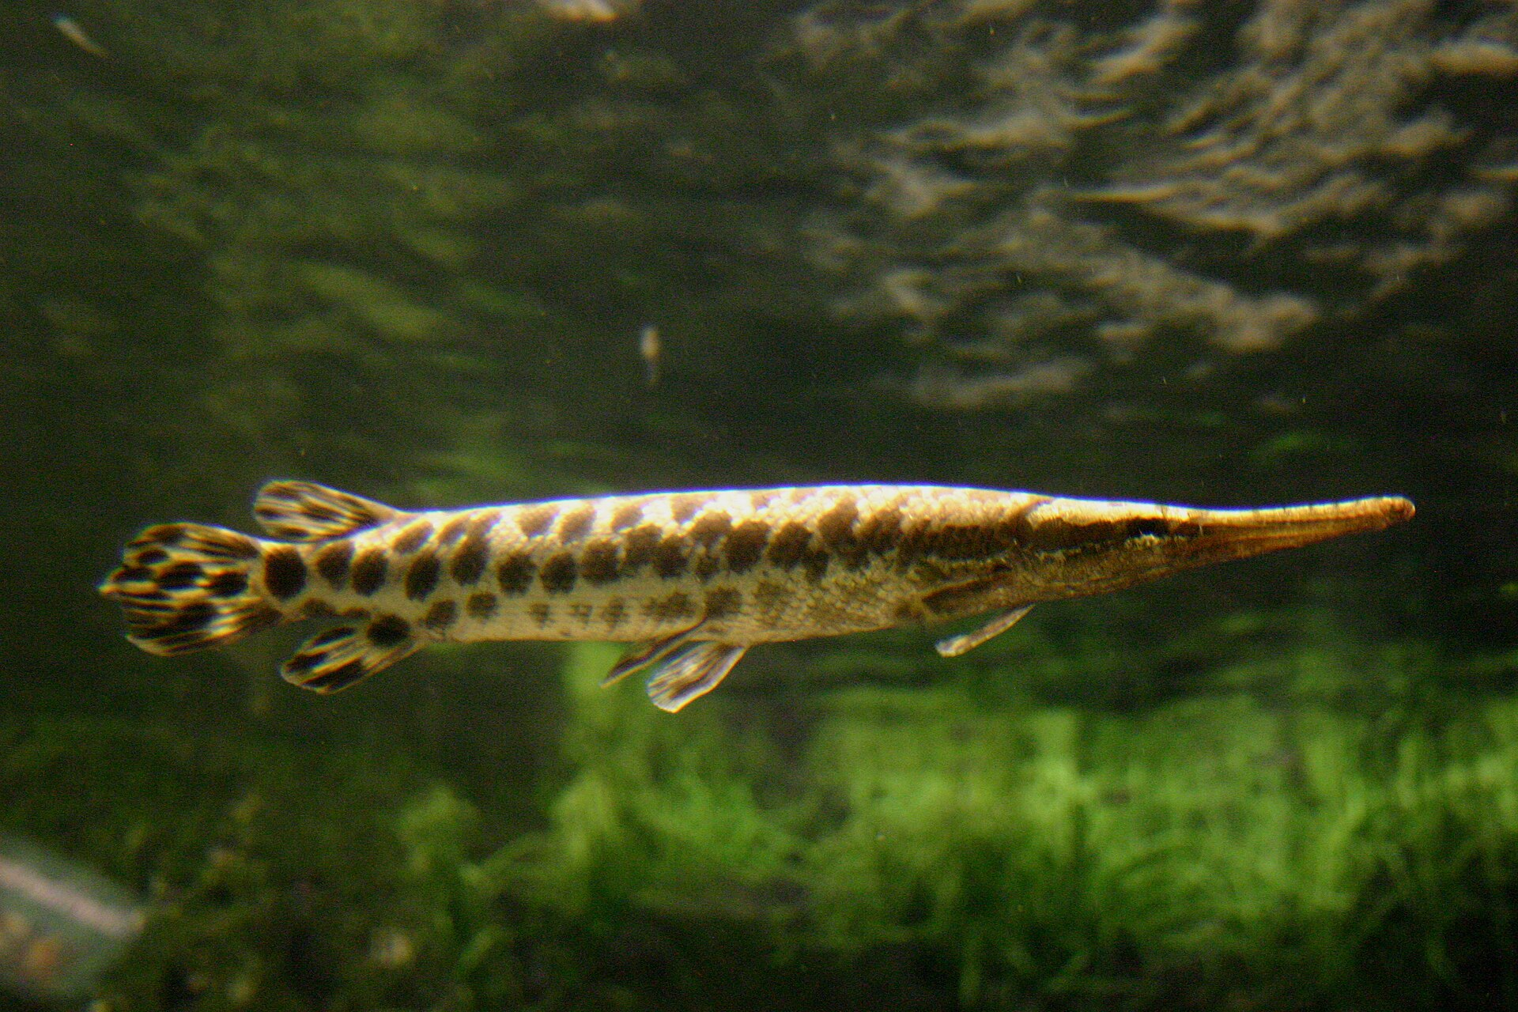
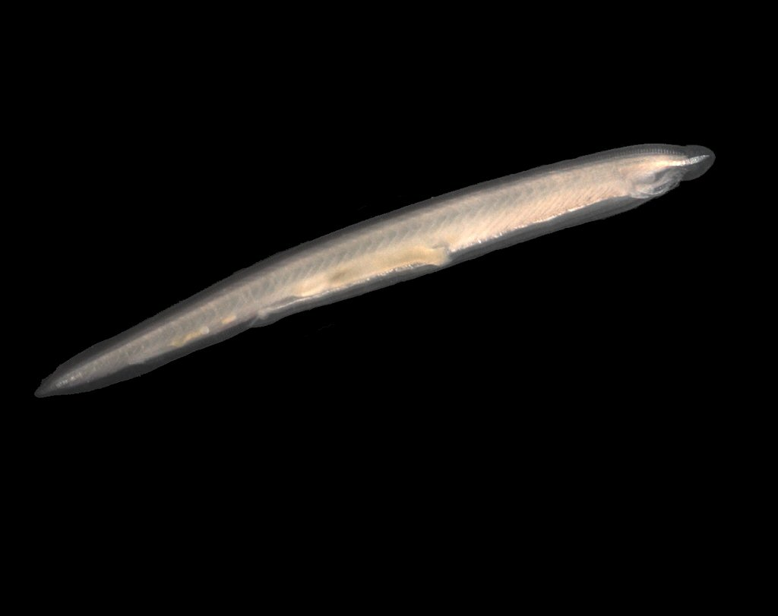
Results - subfamily placement
Benchmarking over 3 outgroup species
Species removed from the database
Positive if placed into a correct family and subfamily (not overspecific)
OMAmer subfamily placement is more accurate than using the closest sequence !

Slide 30
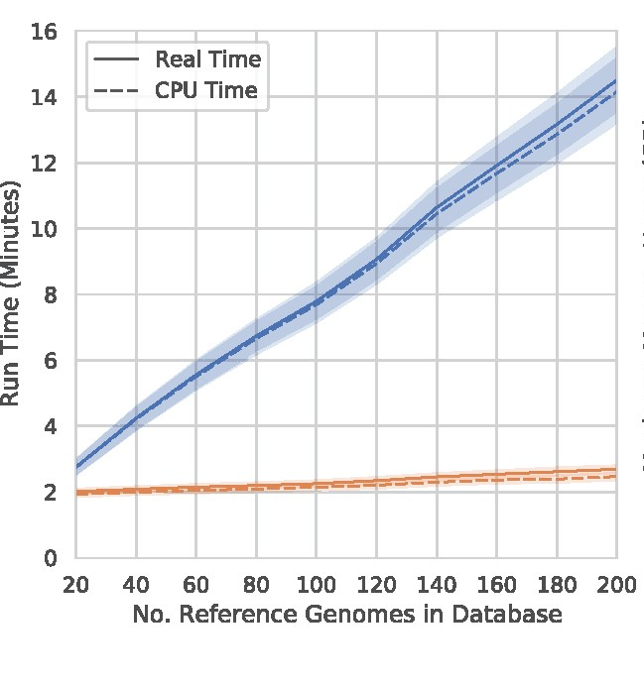

OMAmer performances
Runtime for placing all proteins from 20 metazoan proteomes relative to database size
OMAmer scales better than similarity search softwares !
OMAmer 2.1.0 (1 thread)
20,000+ proteins placed in a database of 2,927 diverse genomes in 4:30 minutes using 13.3 Gb

Slide 31

OMAmer usage
omamer search --query query.fa --db db.h5 --output results.txt
Proteome
>Seq1
MXXXXX
>Seq2
MXXXX
>Seq3
MXXXXX
Query sequences
FASTA format
From any species
Seq1 HOG:D0578800.1c.1d
Seq2 HOG:D0571029
Seq3 HOG:D0606120.3n
OMAmer output
Tab separated format
All HOG placements
OMAmer database
HDF5 format
Built with HOGs from the OMA Browser

Slide 32
OMAmer output
qseqid | hogid | hoglevel | family_p | family_ count | family_ normcount
Seq1 | HOG:D0630083.1g.9c.31d | Theria | 858.4562422 | 133 | 0.970765763
Seq2 | HOG:D0630583 | Gnathostomata | 1002.895597 | 122 | 1
subfamily_ score | subfamily_count | qseqlen | subfamily_medianseqlen |  | qseq_overlap
0.9298 | 53 | 143 | 143 |  | 1
1 | 122 | 128 | 155 |  | 1
https://github.com/DessimozLab/omamer

Slide 33
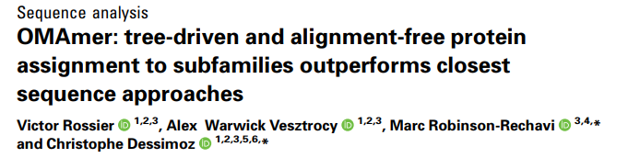
OMAmer references
Victor
Rossier
GitHub : https://github.com/DessimozLab/omamer

Slide 34
OMAmer use-case
Scalable orthology assignment with FastOMA

Slide 35
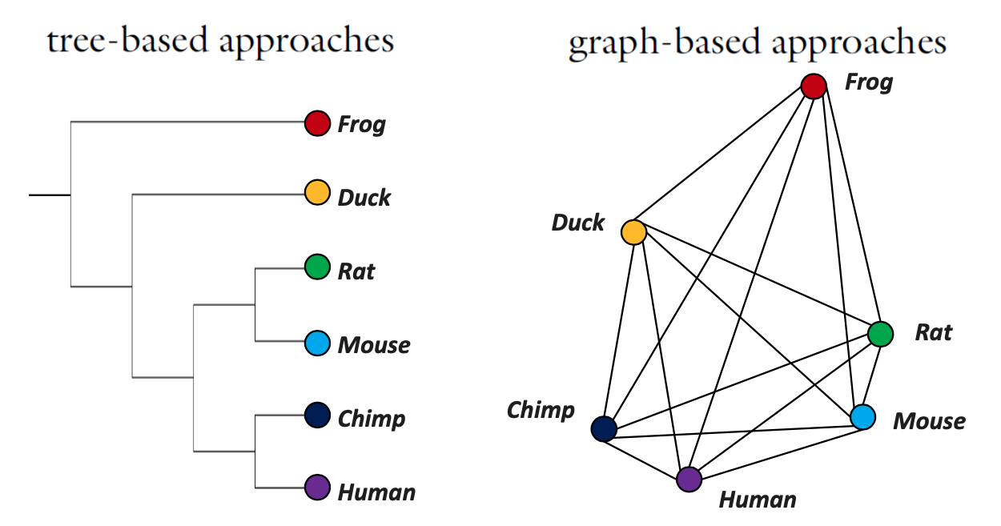





OMAmer use case: speeding up orthology inference
Specie number in orthology
databases
Method/resource | # species
 | 2,851 | Graph based
 | 20,110 | Graph based
 | 6,000 | Tree based
 | 12,535 | Graph + tree
 |  | Graph + tree
❌ All-vs-all comparison
R. Waterhouse. Biodiversity Bioinformatics. SIB course.
The Quest for Orthologs orthology benchmark service in 2022. NAR.

Slide 36
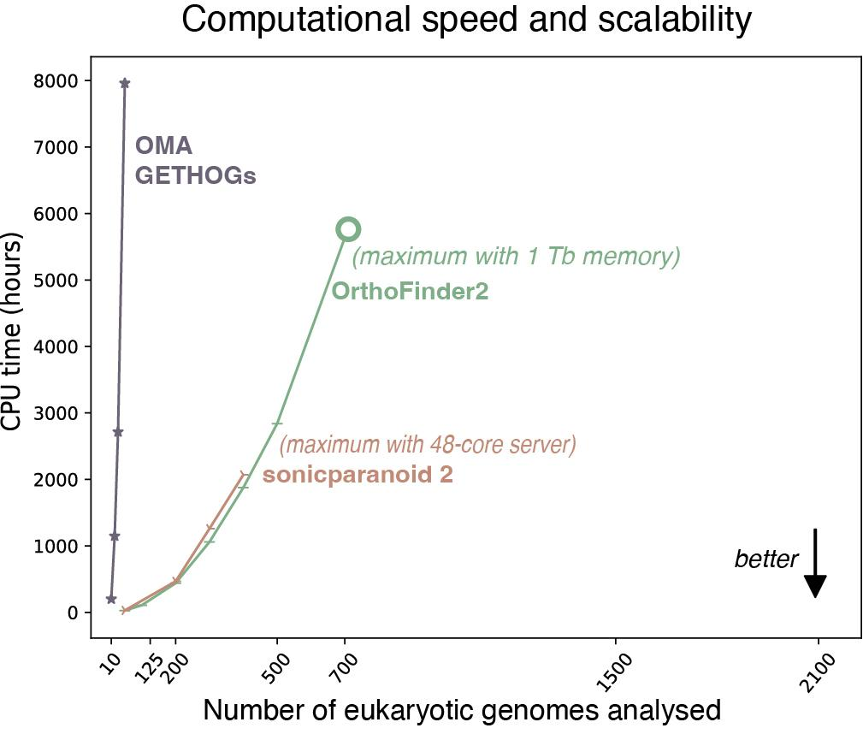
Bottleneck in orthology inference
Dataset : UniProt reference eukaryotic proteomes
Existing methods have a hard time scaling to thousands of proteomes !

Slide 37

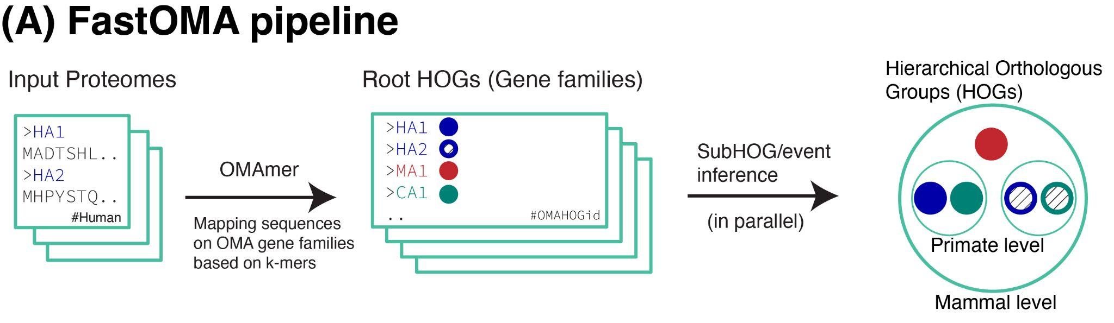
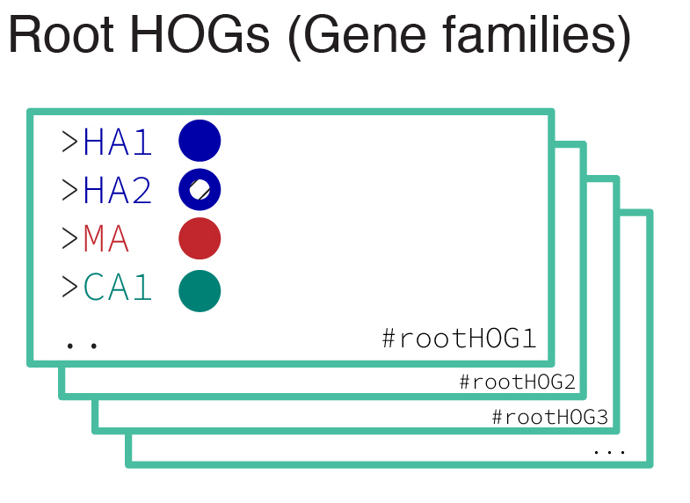
FastOMA
Sina
Majidian
OMAmer family placement is used as pre-assignment of orthologous groups
All other computations are done within a HOG - no all-against-all
Majidian et al, Orthology inference at scale with FastOMA, 2025

Slide 38
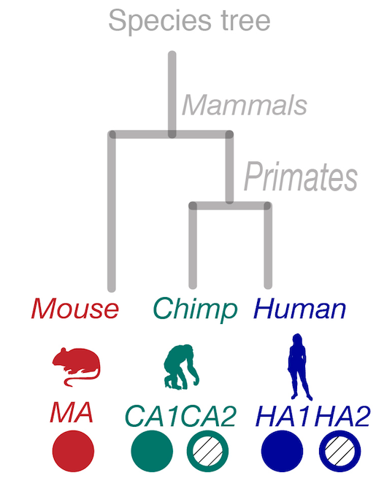
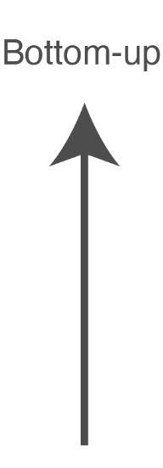
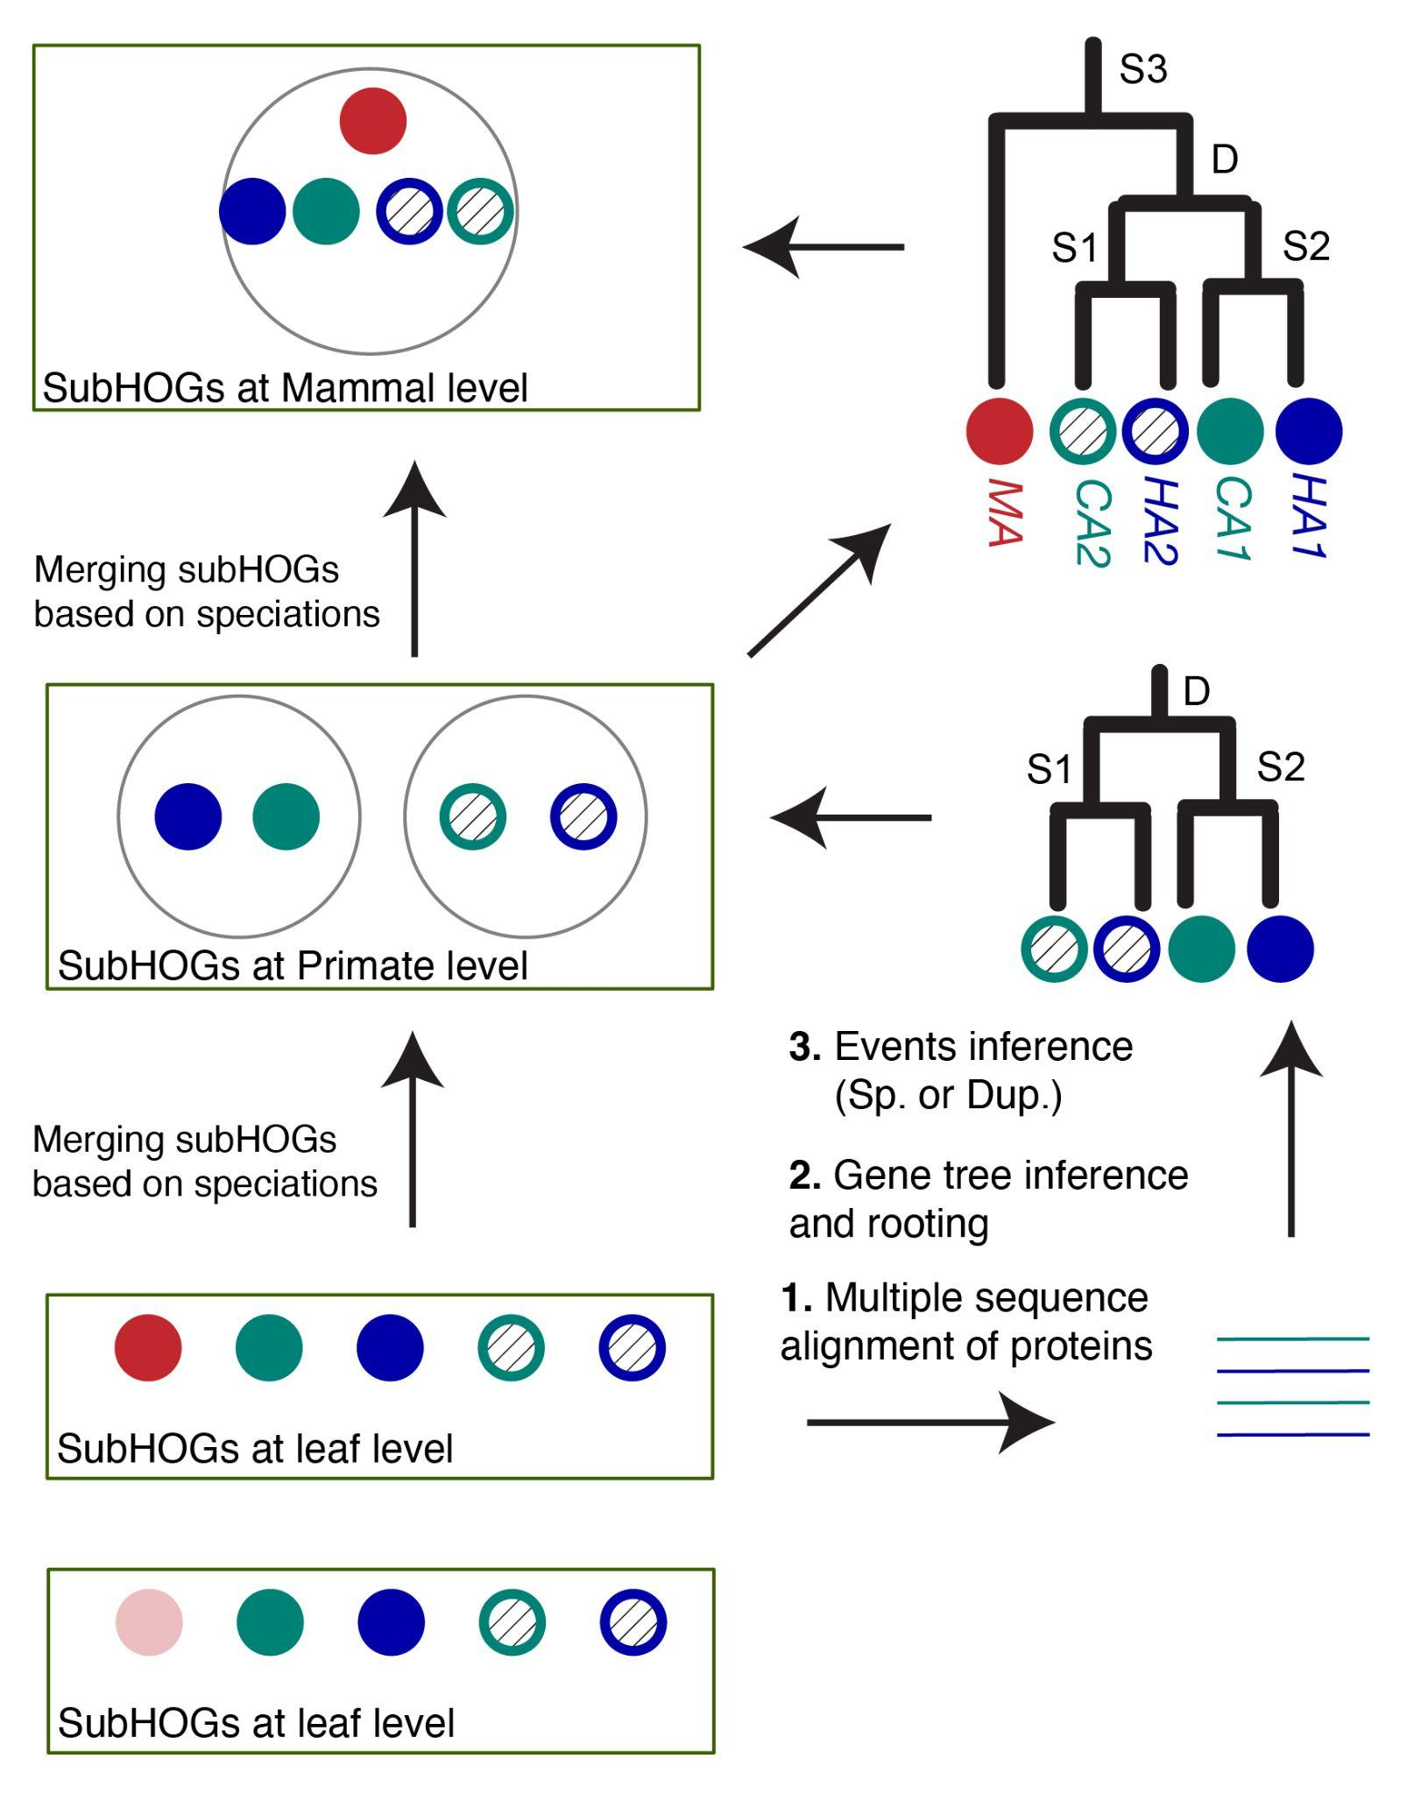
FastOMA - Orthology inference
Majidian et al, Orthology inference at scale with FastOMA, 2025

Slide 39
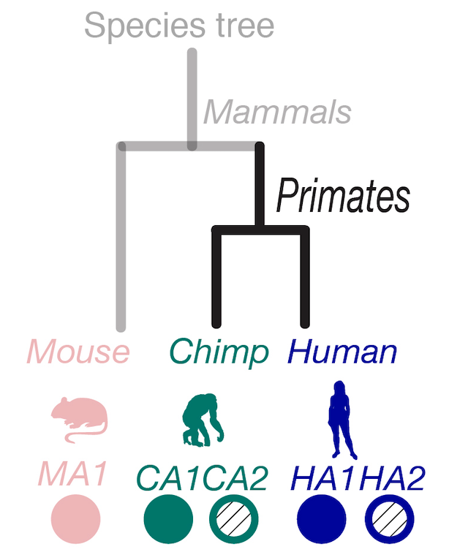
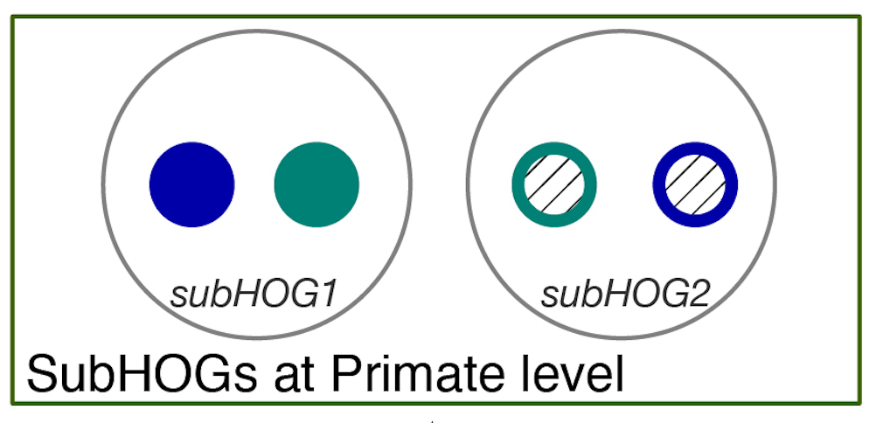
FastOMA - Orthology inference
Majidian et al, Orthology inference at scale with FastOMA, 2025

Slide 40
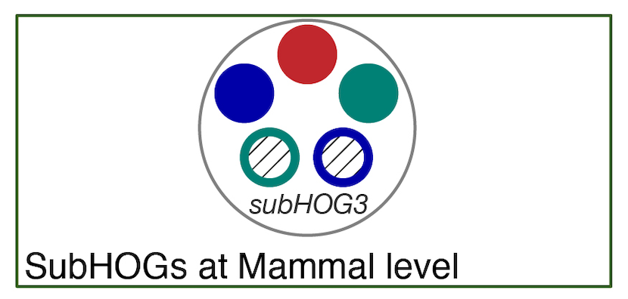
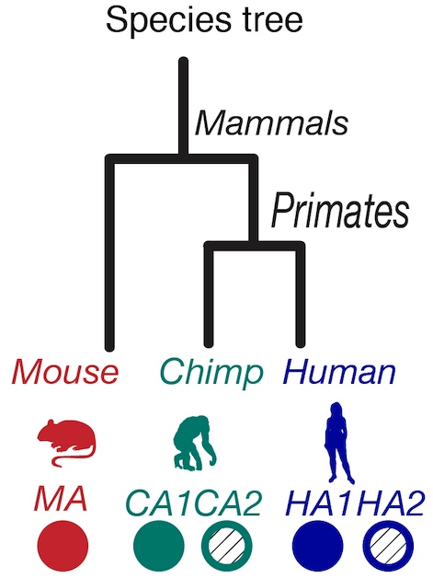
FastOMA
Majidian et al, Orthology inference at scale with FastOMA, 2025

Slide 41
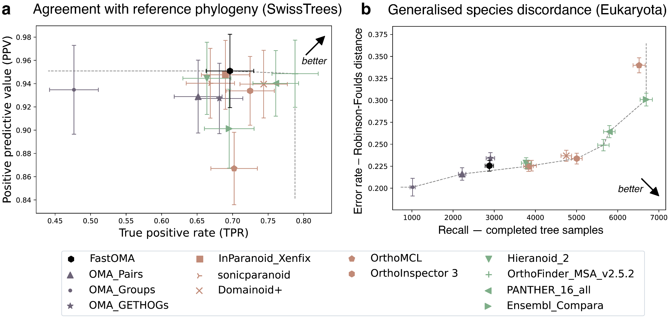
FastOMA orthology benchmarking

Slide 42
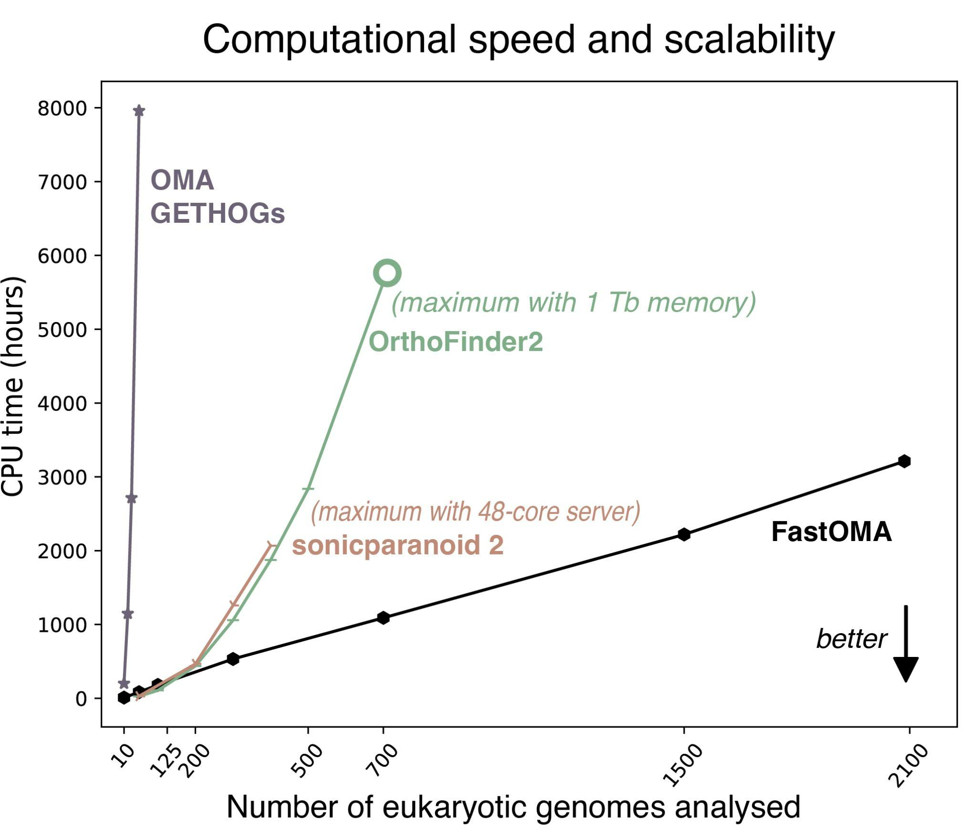
FastOMA speed
Dataset : UniProt reference eukaryotic proteomes
In a single day using 300 CPUs

Slide 43
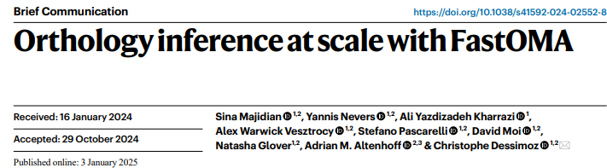
FastOMA references
Sina
Majidian
GitHub : https://github.com/DessimozLab/FastOMA

Slide 44
OMAmer use-case
Homology-based quality control
of structural gene annotation (proteome)

Slide 45
OMAmer use-case : proteome quality
Coding-gene repertoire : set of coding-genes annotated on a given genome sequence
Available on database as proteomes
{
Missing genes
Fragmented genes
Inclusion of non-coding regions
Contamination
Subject to quality issues
How to use gene family assessment to detect these issues?

Slide 46
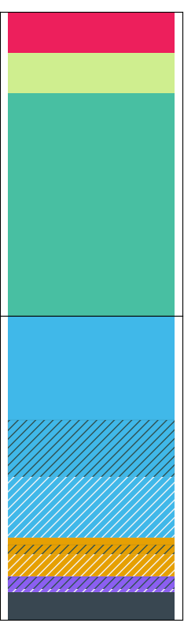

OMArk pipeline
Input
Step 1 :
Gene family placement
Step 2 :
OMArk Quality assessment
mer
QA Summary
OMAmer database
(Defined at LUCA)
~2,500 species
Fast k-mer based mapping of proteins within gene families (HOGs)
Proteome
>Seq1
MXXXXX
>Seq2
MXXXX
>Seq3
MXXXXX

Slide 47
Gene families for quality assessment
Ancestral lineage :
Latest ancestor clade with 5+ representatives in OMA
Dynamically selected from taxid or from the placements
Conserved ancestral genes
Conserved ancestral genes:
Gene families defined at the ancestral lineage level (ancestral gene repertoire)
Present in at least 80% species
Assessed proteome

Slide 48
Gene families for quality assessment
BUSCO
OMArk
Conserved ancestral genes
Missing
Completeness
Duplicated
Single copy
Assessed proteome

Slide 49
Gene families for quality assessment
Lineage consistent genes
OMArk
BUSCO
Conserved ancestral genes
Missing
Completeness
Duplicated
Single copy
Lineage consistent genes
Gene families with at least one representative from the lineage
Assessed proteome

Slide 50
Gene families for quality assessment
Lineage consistent genes
OMArk
BUSCO
Conserved ancestral genes
Consistent
Contamination
Consistency
assessment
Inconsistent
Unknown
Assessed proteome

Slide 51

Species detection
HOG placement is associated to the taxon at which a subHOG is located
This can be used to identify the species in the dataset
Select the most specific clade in a branch with highest HOG representation
Control for database species imbalance
Control for duplication rate

Slide 52




Structural consistency
OMArk use database knowledge and kmer location information to evaluate gene structure
Fragment
Partial mapping
Query is less than half the median size of the gene family
Matching k-mers are concentrated only to
part of the query (20% or more not covered)

Slide 53


Example result
Source: London zoo
100
Missing - 8%
80
Duplicated - 6%
60
Platysternon megacephalum
Single - 86%
% of conserved HOGs
40
Clade : Archelosauria
10,514 conserved HOGs
20
0
Consistent - 82%
20
Contamination - 2%
(Proprinobacteria)
40
Inconsistent - 2%
Number of genes :
21,371
% of proteome
60
Unknown - 14%
80
Partial mapping
100
Fragment

Slide 54

Simulation : completeness
Homo
sapiens
Drosophila melanogaster
Arabidopsis thaliana
Mytilus
coruscus
Reticulomyxa
filosa
Hibiscus
syriacus
OMArk
Completeness
BUSCO
Completeness

Slide 55


Simulation : erroneous sequences
Protocol : Add randomly generated sequences; by increments of 10% of its size
Homo
sapiens
Drosophila melanogaster
Arabidopsis thaliana
Mytilus
coruscus
Reticulomyxa
filosa
Hibiscus
syriacus
Consistency
Proportion of added random amino acid sequences

Slide 56



Use-case : annotation comparison
Bumblebee
(Bombus impatiens)
Ensembl Metazoa 52
15,896 proteins
July 2022
Ensembl Metazoa 53+
10,632 proteins
Current
% of conserved HOGs
% of proteome

Slide 57

Results on public proteomes
Results on public data:
2,615 UniProt Reference proteomes
1,751 Ensemb proteomes
4,528 NCBI (Refseq-GenBank) proteomes
User-uploaded proteomes
https://omark.omabrowser.org/

Slide 58
Take-home messages
Protein k-mers is an efficient way to compare protein-coding genes and gene set
They carry evolutionary and functional information
Mainly used for fast similarity search and sequence classification
Untapped potential for sequence analysis and global gene set comparisons ?

Slide 59
Take-home messages
OMAmer combine a structured homology database and k-mer composition comparisons for fast mapping to gene family
Fast and accurate mapping allows :
Scaled-up orthology inference
Whole proteome quality assessment
Species identification and gene structure evaluation

Slide 60








Acknowledgements
Christophe Dessimoz
Natasha Glover
Victor Rossier
Alex Warwick
Sina Majidian
David Moi
Silvia Prieto
Stefano Pascarelli
Irene Julca

Slide 61
thank you

Slide 62
Additional slides

Slide 63
“P-values” in OMAmer
Probability of having n matches to a HOG at random depends on :
The number of k-mers in a HOG
The frequencies of these k-mers
Modeled as a drawing with replacement problem
What is the probability of n hits to a HOG given q (number of unique k-mers in the query) trials ?
Success : drawing a k-mer that belongs to the target HOG in the database
p sampled from the binomial distribution
Assumption 1 : k-mers are independants (╳)
Assumption 2 : a same k-mer can be found twice (but is q really small)
https://github.com/DessimozLab/omamer

